Slide 1

NATIONAL INSTITUTE OF TECHNOLOGY PUDUCHERRY
(An Institute of National Importance under MHRD, Govt. of India)
KARAIKAL – 609 609
Department of Computer Science and Engineering
CS1603- Final Review
29.04.25
Fake News Detection using Machine Learning Models
Faculty In-charge
Project by
Jerome B(CS22B1019)
N Kathiravan(CS22B1036)
Sairam S(CS22B1048)
Dr. Venkatesan M
Assistant Professor
Department of Computer Science and Engineering

Slide 2
Introduction
Fake news poses threats in health, politics, and society due to rapid online spread.
Goal: Identify the most accurate model for fake news detection.
Datasets used: LIAR, Getting Real About Fake News, All the News.
Compared ML models: SVM, RF, Naive Bayes, XGBoost, KNN, GDBoost, SVM+RF+XGB.
Compared DL models: RNN, LSTM, GRU+CNN, GRU+RNN, RNN+LSTM (proposed).
Input: Tokenized and padded sequences (max_len=100).
Output: Binary (True = Real, False = Fake).

Slide 3
Existing Work (Base Paper)
Rapid spread of fake news via social media, impacting health (e.g., COVID-19 infodemic), politics, and finance.
The paper presents a machine learning-based system using:
TF-IDF with Bag of Words and n-grams for feature extraction.
Support Vector Machine (SVM) as the classifier.
This paper has achieved an accuracy of 52.30 using sentiment, .
No mention of deep learning models or advanced NLP transformers.

Slide 4
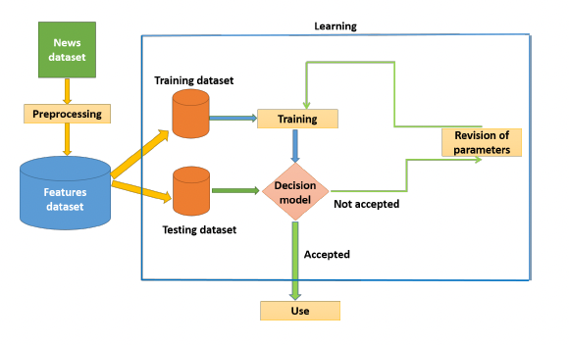
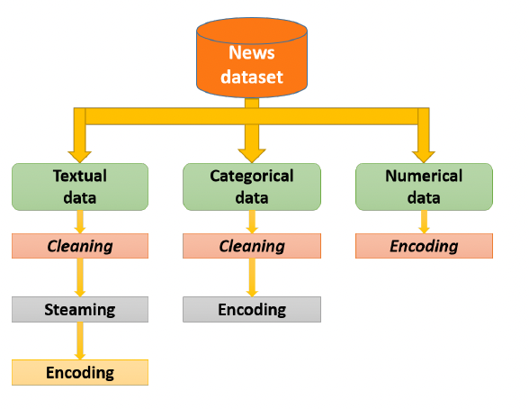
(Base Paper) Model or architecture
Suitable diagram
Proposed Architecture
Dataset Preprocessing

Slide 5
Gaps
The model heavily relies on metadata. These metadata cannot be consistently available and reliable.
Possibility of model overfitting.
Used only SVM – limited in handling language complexity.
Relied on bag-of-words – ignored word order and context.
No deep learning or hybrid models tested.
Class imbalance not addressed.
No comparative analysis across multiple models.

Slide 6
Proposed Model
1. Embedding Layer: Maps each word to a fixed 300-dimensional GloVe vector.
2. SMOTE: Synthetic Minority Oversampling Technique applied to balance class distribution.
3. SimpleRNN Layer: Captures short-term dependencies in the sequence.
4. LSTM Layer: Captures long-term dependencies and outputs a 128-dimensional vector.
5. Dense Layer: Projects the LSTM output into a 64-dimensional feature space.
6. Output Layer: Produces a single probability score for binary classification.
7. Performance Analysis: Accuracy, Precision, Recall, and F1-score were used to analyze the model’s performance.
This architecture effectively captures both short- and long-term dependencies using SimpleRNN and LSTM layers.
Pretrained GloVe embeddings add rich semantic understanding, while SMOTE helps address class imbalance, making it well-suited for fake news detection.

Slide 7
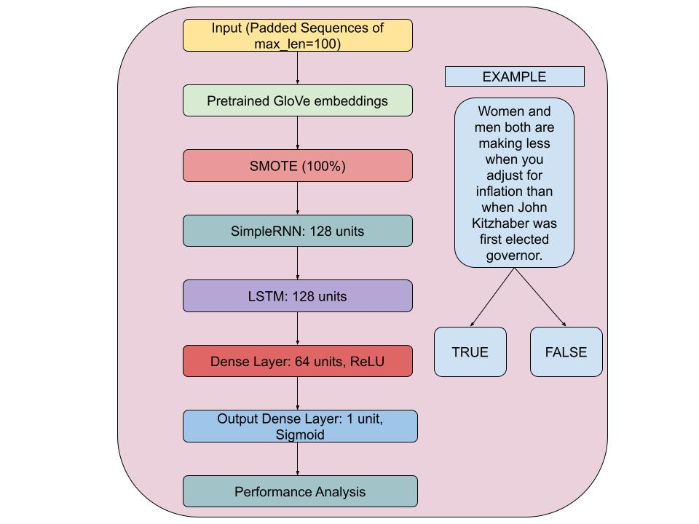
Proposed Model

Slide 8
Results

Slide 9
Results

